Slide 1


Alumni Update
June 10, 2023

Slide 2

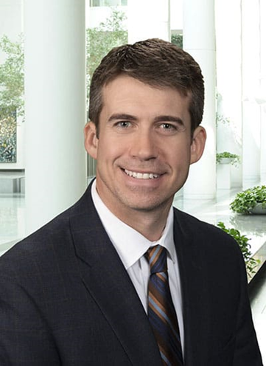
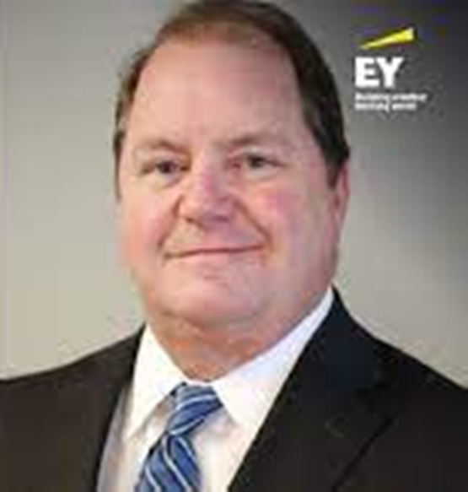
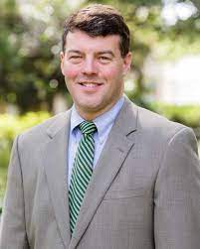
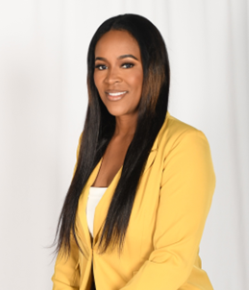
New Trustees
Andrew C. Pourchier ‘98
Art Deas
Jared Downs ‘96
Ketrina Mitchell

Slide 3
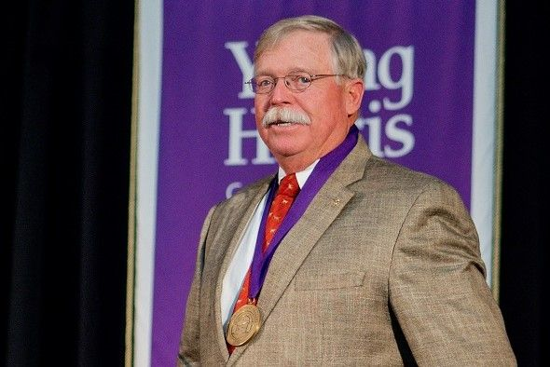
Ray P. Lambert, Jr.
YHC Medallion of Honor

Slide 4

State of the College

Slide 5
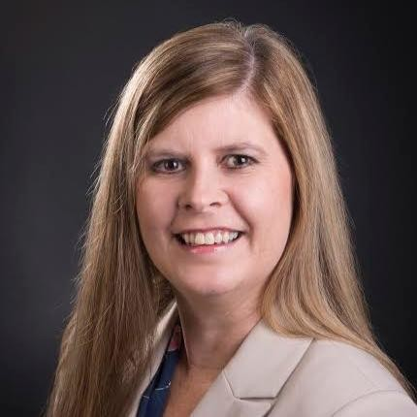
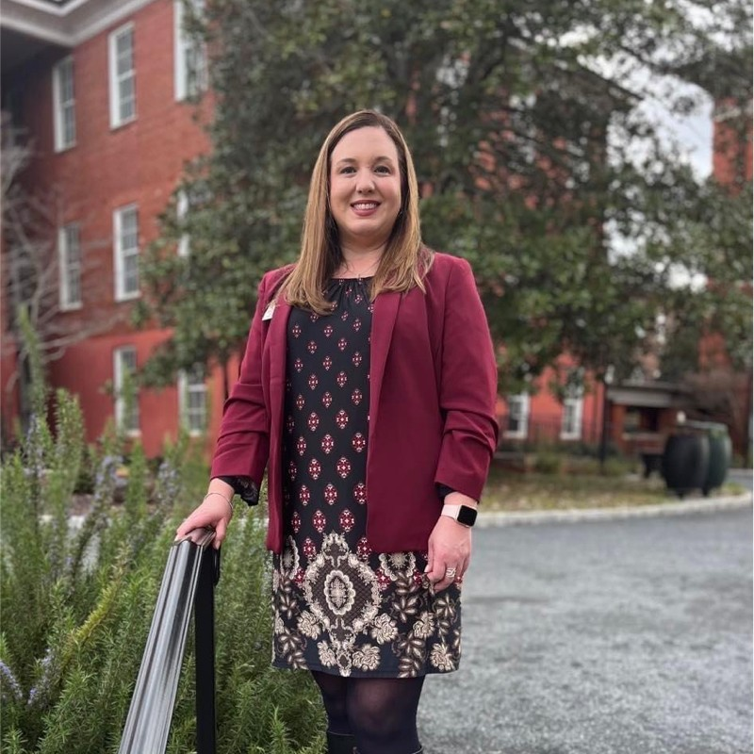
Dr. Joy Hamm
V.P. for Admissions
Dr. Karen Pruett
V.P. for Student Development

Slide 6
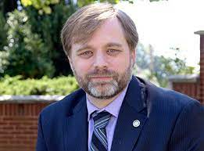
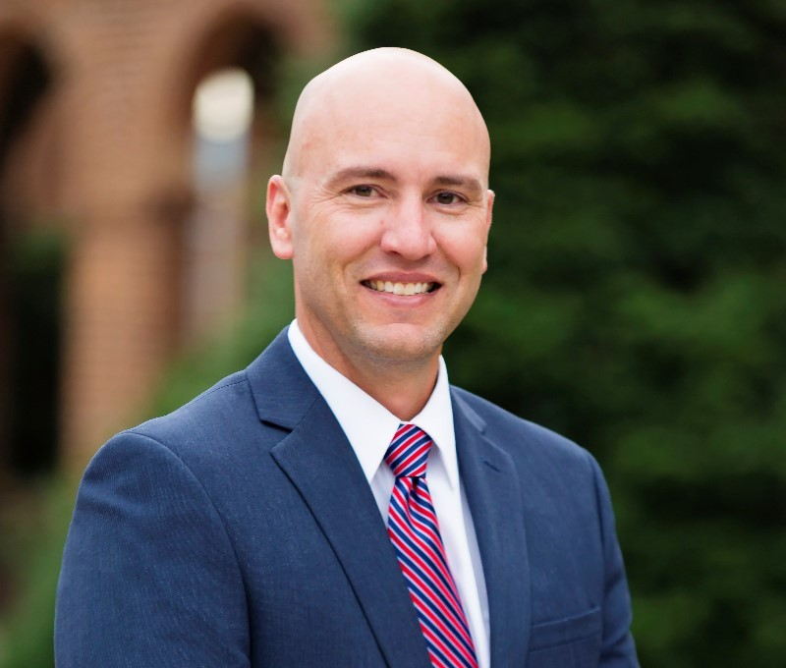
Dr. Jason Pierce
Executive VP and Provost
Daniel ‘Bo” Wright
V.P. for Business and Finance

Slide 7
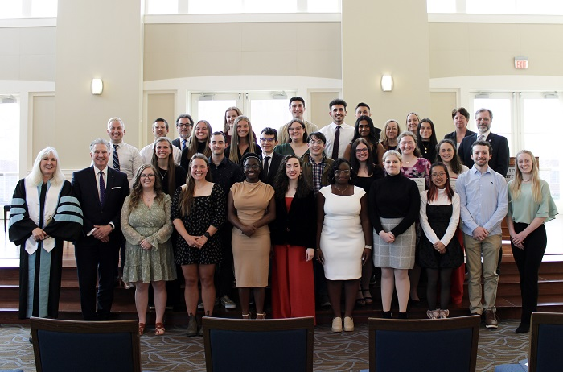

ODK is the oldest Leadership Society in America. There are only 370 active chapters worldwide.

Slide 8
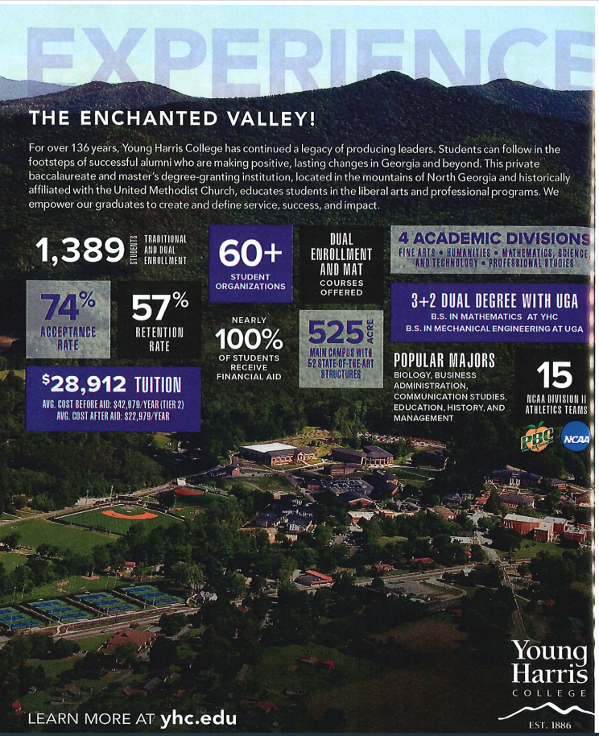
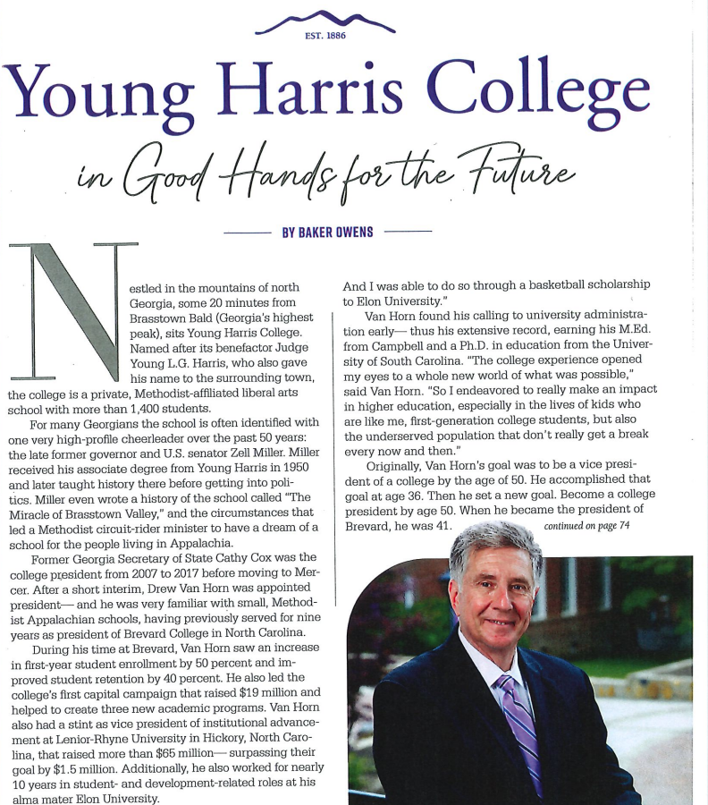
The Influential Issue – JAMES Magazine 2022
92% of Graduates Employed or Grad School

Slide 9
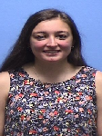
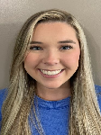
Appalachian College Association Ledford Scholars
Ashley Palmateer
Blairsville, GA
Psychology
Sophia Shook
Hiawassee, GA
Biology

Slide 10
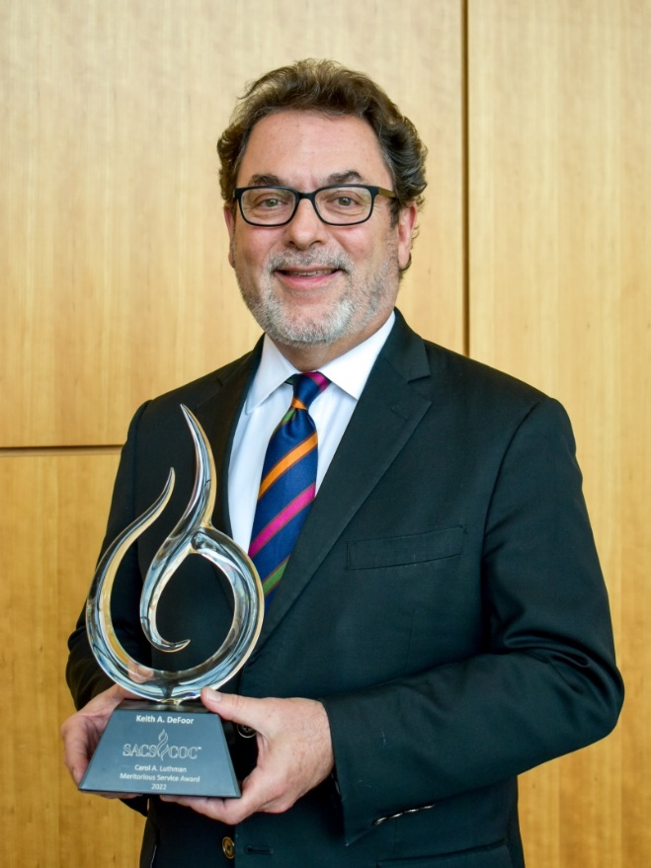
Southern Association of Colleges & Schools Commission on Colleges
Dr. Keith DeFoor
Assoc. VPAA & Dean of Fine Arts
Carol A. Luthman Meritorious Service Award Winner

Slide 11
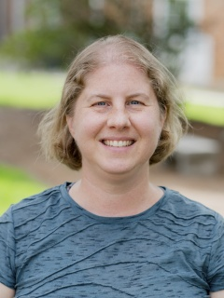
Governor’s Teaching Fellow
Dr. Jenn Schroeder
Assoc. Prof. of Biology
Governor’s Teaching Fellow 2023

Slide 12
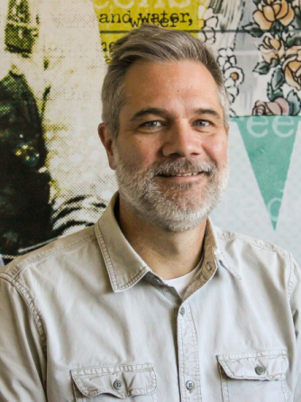
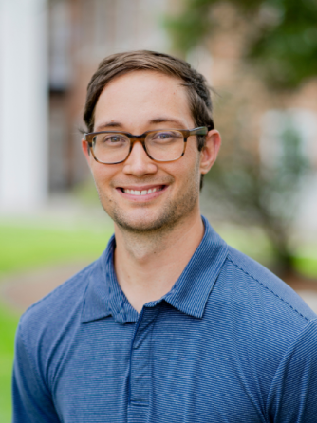
Appalachian College Association Faculty Fellows
Prof. Ted Whisenhunt
Professor & Chair of Art
Summer 2023 Research Stipend
Dr. Alex Barnes
Asst. Prof. & Chair of Mathematics
Spring 2023 Course Release

Slide 13
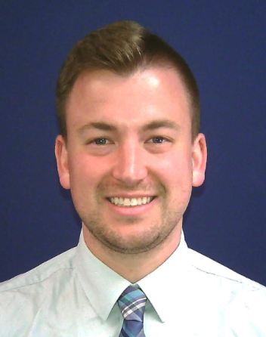
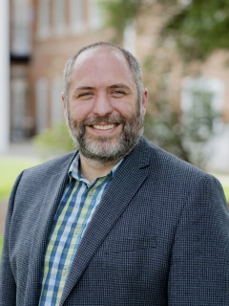
Appalachian College Association Teaching & Leadership Institute
Dr. Ben Van Dyke
Asst. Prof. of Psychology
Teaching Track Faculty
Dr. Matt Byron
Prof. & Chair of History
Leadership Track Participant

Slide 14
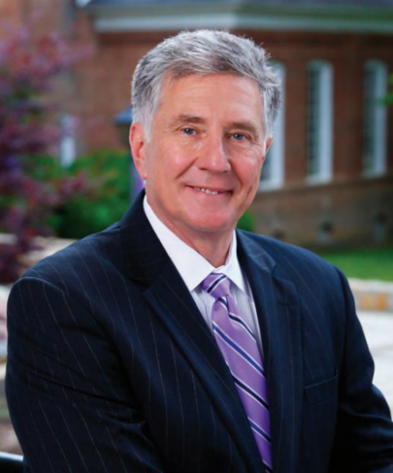
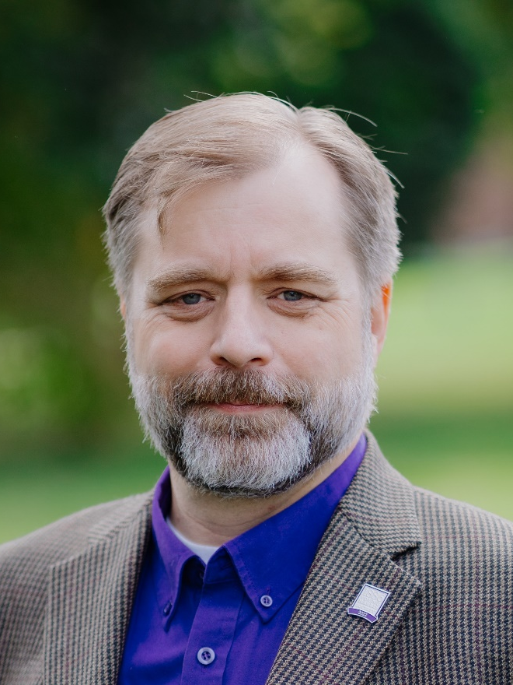
Appalachian College Association Executive Committee
Dr. Drew L. Van Horn
President
ACA Executive Committee
Dr. Jason A. Pierce
Provost
ACA Executive Committee

Slide 15
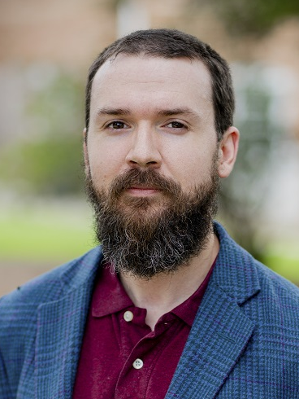
Council of Independent Colleges
Dr. Chris Lay
Asst. Prof. of Philosophy
New Currents in Teaching Philos.
Dr. Jason A. Pierce
Provost
CIC Vocation & Mission Institute

Slide 16
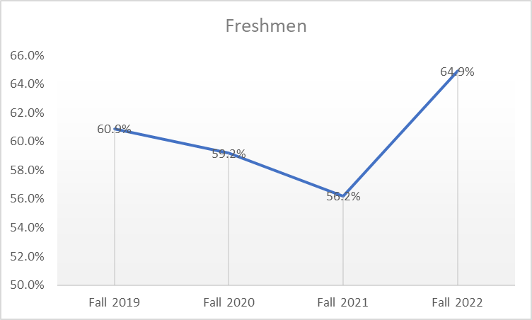
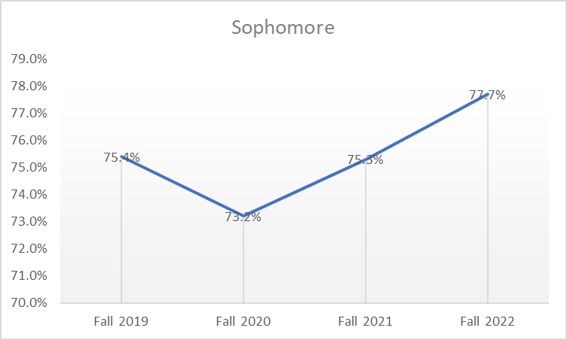
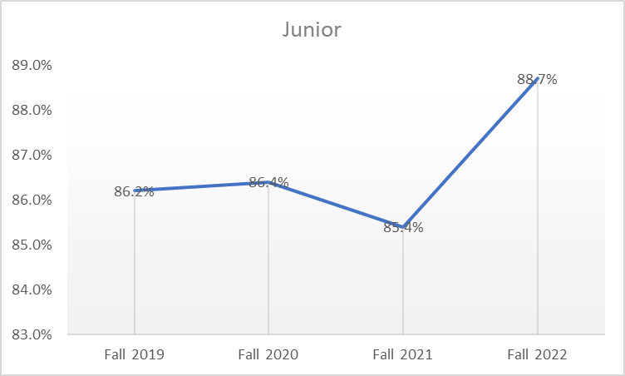
Student Persistence

Slide 17
Diversity, Equity and Inclusion
Initiatives Update

Slide 18
INITIATIVE I
Goal 1
Sustainable Practice: YHC establishes a singular position within the administration that facilitates the advancement of DEI initiatives through the construction and implementation of policy.
Status: Completed. DEI responsibilities are a part of the duties of the Associate Vice President for Policy and Compliance and College Ombuds.
Goal 2
Sustainable Practice: YHC establishes a standing committee that represents the entire campus community. The standing committee maintains an advisory role regarding DEI-centric concerns across campus.
Status: Completed. Committee represents a cross-section of campus, including traditionally marginalized groups and includes students, staff, and faculty.
Goal 3
Sustainable Practice: YHC establishes, maintains, and regularly updates human resource policies that actively recruit candidates from any community. The policies are constructed, maintained, and enforced by the current HR team in concert with the DEIC.
Status: Completed. Director of Human Resources was added to the DEI Committee. Non-Discrimination Policy approved. Process to make a complaint under the Non-Discrimination Policy is in progress. Revision of the Employee Code of Conduct is in progress.

Slide 19
Goal 4
Sustainable Practice: YHC maintains its current system for reporting incidents of discrimination and harassment. The system and its protocols are regularly advertised across campus platforms at least once per semester. Protocols are established for investigating and responding to such reports while ensuring the safety of the claimant.
Status: Completed. Committee developed materials to advertise existing systems and options for reporting harassment and discrimination. An option is available to categorize an incident as discrimination and/or harassment in reporting a General Student Complaint. Implement Fall 2023
Goal 5
Sustainable Practice: YHC dedicates a day every academic year to training on DEI. Coordinated by the DEIC, the annual training includes lectures, activities, and workshops led by premier professionals and academics who work directly with DEI initiatives. Trainings are made available and recommended for all YHC community members, and are constructed to cater to faculty, students, and staff. YHC utilizes its relationship with Gallagher Risk Control to implement its DEI training programs.
Status: Completed (Phase 1)- Optional DEI training was offered Fall 2023. Committee will discuss how to improve participation among employees and explore risk reduction benefits for institution if employee participation rate is higher.

Slide 20
INITIATIVE II
Goal 1
Sustainable Practice: YHC maintains its current system for reporting incidents of discrimination and harassment. The system and its protocols are regularly advertised across campus platforms at least once per semester. Protocols are established for investigating and responding to such reports while ensuring the safety of the claimant.
Status: Completed.
Goal 2
Sustainable Practice: YHC establishes supplementary positions among existing employees to support the current HR employee designated to address both employee and student related DEI initiatives.
Status: On Hold. Additional positions are not currently under discussion.
Goal 3
Sustainable Practice: Retain bathroom signage that has already been changed but make no additional changes to single-stall restrooms throughout the remainder of campus.
Status: On Hold. This may intersect with New Title IX rules and direct the institution’s next steps.

Slide 21
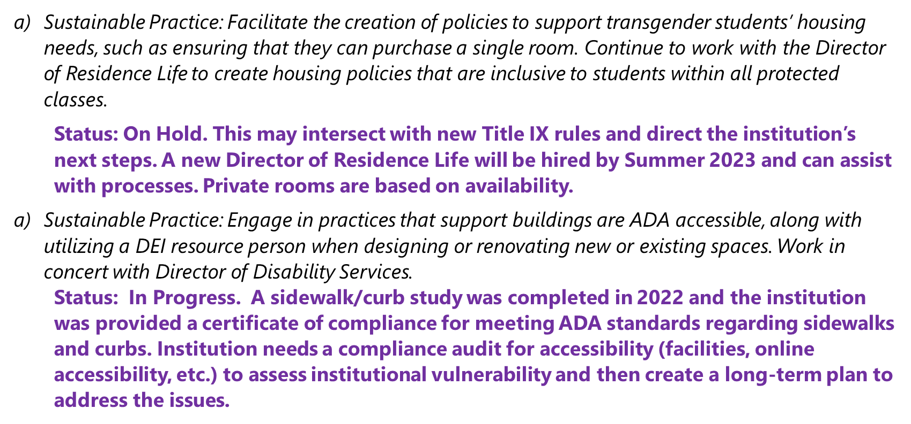

Slide 25
Strategic Plan

Slide 26
YHC Three/Five Year Strategic One Pager
Mission = “Why”
YHC is your warm-hearted community of learners transforming lives into passion and purpose.
Suggestions: at the intersection of passion and purpose; through passion and purpose
Core Values = “How”
Community – we value individuals and their unique contributions to the learning experience.
Integrity – we are individually and collectively accountable, transparent, honest, and gracious.
Innovation – we win and lead by embracing creativity and the ever-changing liberal arts.
Legacy – we are committed to the timeless Wesleyan tradition of cultivating trained minds and warm hearts.
Responsibility – we collaborate to advance a free society, stewarding resources in a fiscally responsible and sustainable manner to make today and tomorrow better.
Diligence – we prepare our students for meaningful professional success.

Slide 27
North Star/Vision = “Where”
We will become Georgia’s most desirable private and residential College for Georgia Students.
By Fiscal Year 2026
Achieve 90% placement of graduates within six months of graduation.
Achieve faculty and staff retention of at least 80%.
Achieve 70% coverage of operating expenses via net student revenues.
Achieve $2.2 MM in unrestricted annual fundraising.
By Fiscal Year 2028
Achieve a cohort graduation rate of 55%.
Achieve faculty and staff retention of at least 85%.
Achieve admission waitlist.
Grow College held endowment to $60 Million.

Slide 28
Brand Awareness

Slide 29
GROW
Marketing Campaign
GROW Knowledge emphasizes the academic aspects of life at YHC, encompassing all divisions and majors, as well as opportunities for undergraduate research and experiences outside of the classroom
GROW Knowledge. YHC offers unique educational experiences inside and outside of the classroom.
GROW Confidence emphasizes the personal, professional, academic, and social growth fostered at YHC, especially through professional studies and business degrees
GROW Confidence. YHC cultivates academic, personal, and professional skills for success.
GROW Innovation emphasizes the modernity and cutting-edge aspects of the historical College and speaks to the dreamers and doers from more technical, science, and mathematics related departments
GROW Innovation. YHC encourages students to bring fresh ideas and approaches to modern frontiers.

Slide 30
GROW Creativity emphasizes the fine arts, performance arts, creative writing, and many other creative outlets cultivated on campus that distinguish YHC from rigid, regimented learning environments
GROW Creativity. Explore and sharpen your craft through YHC’s many creative outlets.
GROW Connections emphasizes the friendship, brotherhoods/sisterhoods, mentorships, and professional relationships that make up the YHC experience
GROW Connections. Our vibrant culture creates lasting bonds that inspire your journey beyond YHC.
GROW Forward emphasizes a sense of direction and momentum derived from an understanding of the humanities, such as history, English, communications, popular culture, and gender studies
GROW Forward. YHC prepares you to be an informed and positive force of change in your field.
GROW Together emphasizes the unity between students and their peers across majors, highlighting the community and connectedness of the YHC experience, and organizational and research collaboration
GROW Together. Thrive as a member of the YHC’s close-knit and collaborative community.

Slide 31
GROW Perspective emphasizes the expanding worldviews of students who are involved and invested in a diverse campus community and curriculum, expanding both culturally and academically
GROW Perspective YHC students expand their worldviews through a diverse campus and curriculum.
GROW Curiosity emphasizes the life-long journey of learning fostered at YHC, and programs that encourage inquisitive students and equip them to forge new intellectual paths towards their interests
GROW Curiosity. YHC invites you to delve into all of your interests in search of new possibilities.
“Success is Expected”

Slide 32
Enrollment
Except for flag-ship institutions, all other areas of higher education in Georgia have experienced a decline in undergraduate enrollment.
  Enrollment grew by 1.2% at research universities but declined in the system’s three other institutional sectors, according to USG’s Fall 2022 Semester Enrollment Report. Comprehensive universities fell -3.7%, state universities were down -5.7%, and state colleges dropped -2.4%.
Georgia is projected to see a 10% to 20% reduction in the number of high school graduates. The same reductions are projected for North Carolina, Tennessee, and Alabama.
Georgia’s public institutions of higher education have become greater competitors
The percentage of high school seniors choosing not to attend college has grown from 19.4% to 22.4%.
HOPE for USG System Students will now cover full tuition
Fall 2023 Goals
510 Returners Actual 536
350 New On Target

Slide 33
Enrollment Strategy
Increased Expenditure in Marketing
Greater Capture of Market Share Through Brand Awareness (Change of Marketing Partner enrollment Fuel)
    Target Marketing (Bus Prospective Students for Day on Campus)
Market Strategy for Transfer Students (Focus on students in close proximity to College)
Market Strategy to Applicants that did not attend a College (400 applicants from last year)

Slide 34
New Athletic Conference

Slide 35
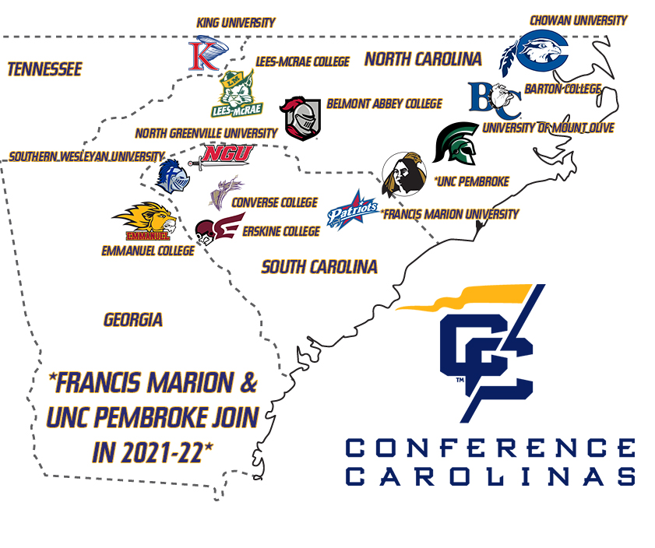


Shorter College
YHC

Slide 36


